Slide 1
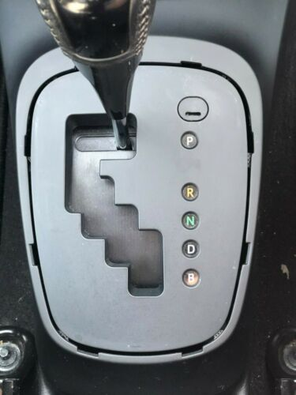
Expected behavior
P
Negative speed:
reverse direction
[|v| < 5 km/h
AND brake pedal pressed]
Consider this selector:
[Brake pedal pressed]
[v < 5 km/h AND
brake pedal pressed]
No conditions
No conditions
B
D
N
R
[Pedal > 1/3]
[v > -5 km/h AND
brake pedal pressed]
No conditions
Toyota Yaris Hybrid
The input selector position is not shown since it is trivial.
The state corresponds to the state shown on the dashboard.
P→R passes automatically through N
for a short time

